Slide 1
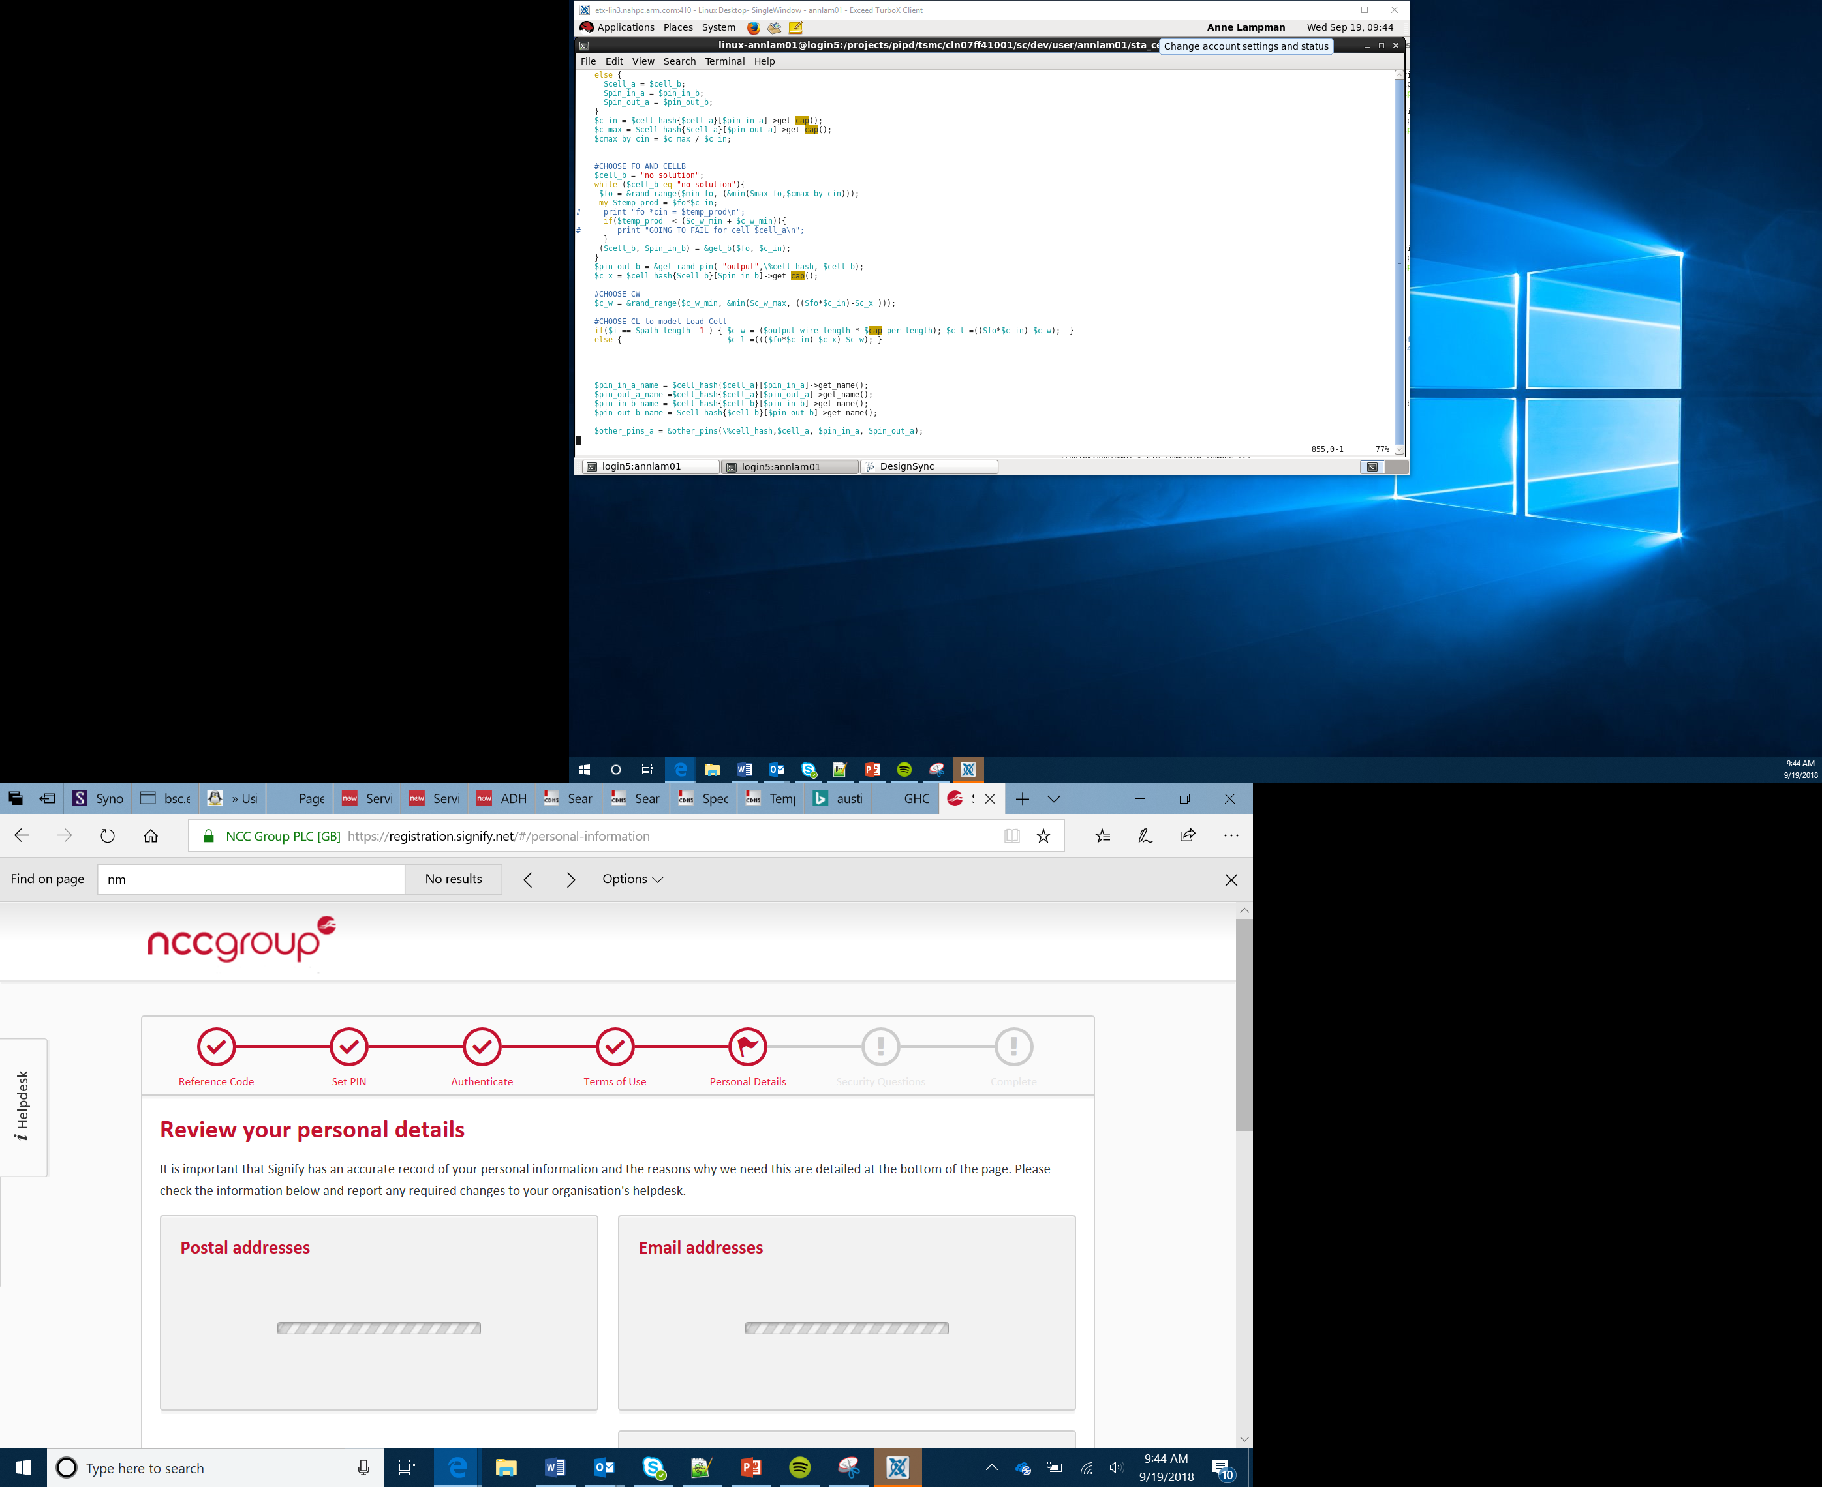

Bit:Bot Race Car Project
Body Shell
Lesson 10

Slide 2
Objectives
Design and develop a body shell for the racing Bit:Bot where:
The brand requirements looks good and will encourage sales
The design is functional and protect key components from damage (including the occupants)
The design is lightweight and aerodynamic to enable you to have the best chance of winning your race

Slide 3
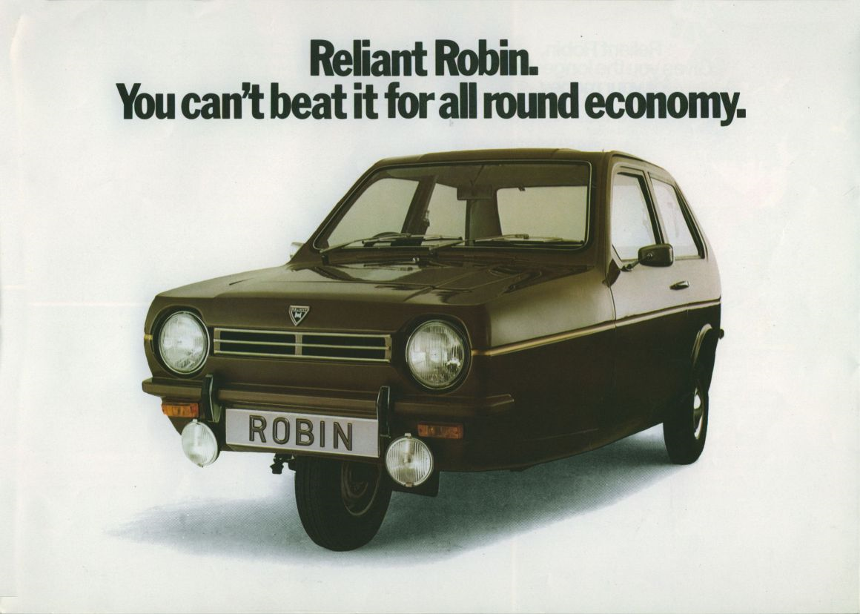
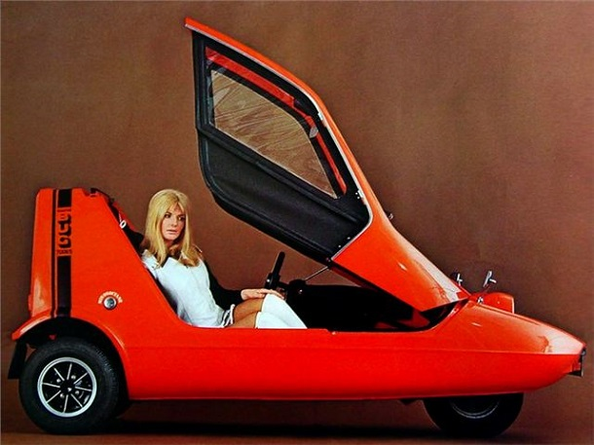
Bit:Bot Race Car Body Design
The Challenge
What is the most important part of the body design
Aerodynamics?
Looks?
Style?
Weight?
That’s down to you to decide!
Notes:
Probably can’t use these two images but something similar would be good. These are original promotion ads for the robin and bond bug and are good to show how design impact sales as they are in essence the same vehicle built by the now defunct Reliant Motors
Remind Learners of the scenario and overall project aims
Discuss how Aerodynamics, Looks/Style and weight are all important aspects of car design – Give examples of how good aerodynamics but poor styling can impact sales (eg Reliant Robin v Bond Bug)
Talk Learners through the activity sheet

Slide 4
Iterative Design
Prototyping
Iterative design is a design methodology based on a cyclic process:
Testing
After testing the most recent iteration of a design, changes and refinements are made
This process is intended to ultimately improve the quality and functionality of a design
Revising
Analysing
Notes:
Explain the concept of iterative design

Slide 5
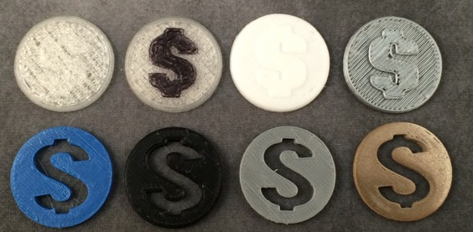
Iterative Design - Example
Daddy Dollar
The designer wanted to give a reward to his children that he ‘caught’ being good
The first Daddy Dollar was created in Tinkercad as a beveled disc with a dollar sign printed in clear PLA. The model worked as a token
The second iteration used a Sharpie to highlight the dollar sign so that the symbol would pop
The third iteration tried an opaque filament instead of transparent
The fourth iteration out of a grey filament echoes a metal coin
The fifth iteration has the symbol punched through the disc so that it can be seen on either side as well as being strung together on a string. The new version prints more quickly and uses less material
The sixth iteration uses a darker colored filament
The seventh iteration returns to the grey filament to more closely resemble filament
The eighth iteration uses BronzeFill from ColorFabb to closely emulate metal coin
Notes:
Use the Daddy Dollar (open commons licence) from (http://www.thingiverse.com/thing:1013953/) and
https://designmaketeach.com/2015/09/14/iterative-design/ as an example of how iterative design works
Small steps, improving each time

Slide 6
Iterative Design - Example
Daddy Dollar
Each iteration allowed for experimentation with different layouts, colour and materials
While the difference between individual iterations is small the leap from first to last iteration is huge
Notes:
This video https://www.youtube.com/watch?v=dOSiU42P8Gc if available is an excellent way of illustrating how iterative and critique and revise can help improve designs.

Slide 7
Materials
Cardboard
Lightweight
Impact resistant
Balsa wood
Lightweight
Can be brittle
Paper straws
Good rigidity
High compression strength
Not great in the rain
Easy to cut complex shapes
Can be laser cut for complex shapes
Can be used to support curved shells
Notes:
Get Learners to look and sample different materials – look at their pro/cons for this part of the project (The body shell)
Ask Learners to consider other materials they may be able to incorporate and what features these materials may have – Learners could make a list of additional materials and then see if these are available to them

Slide 8
Body Shell
Nose to tail (including pen holder) – 140mm
Rear axil floor pan width – 75mm
Wheel to Wheel distance – 110mm
Highest point (over battery pack) – 45mm
Access needed for:
On/off switch
Sonar sensors
Light Sensors
Pen mount (if applicable)
LEDs
Notes:
Work through the dimensions of the vehicle – get Learners to confirm the measurements themselves
Remind Learners about needing access for the sensors etc
Work through the worksheet with Learners to develop their prototype design
Ensure that all Learners are able to create a prototype design.

